Slide 1
CSI342 Systems Analysis and Design
Lecture 5 – System Modeling

Slide 2
Learning Objectives
After this chapter, you will be able to:
Explain data flow diagrams
Draw the four basic data flow diagram symbols
Draw context diagrams
Draw diagram 0 data flow diagrams
Draw lower-level data flow diagrams

Slide 3
Process Modeling
Involves graphically representing the functions, or processes that capture, manipulate, store, and distribute data between a system and its environment and between components within a system
A common form of process model is the Data Flow Diagram (DFD) – the traditional process modeling technique of structured analysis and design
A decision table is another technique frequently used to model the conditional logic contained in many DFD processes
A DFD is a picture of the movement of data between external entities and the processes and data stores within a system

Slide 4
Modeling a system’s process for structured analysis
Analysis of requirements in SDLC has 2 sub phases namely:
Requirement Determination – Abundance of information gathered
Requirements Structuring – Analyst and other team members organize the information into a meaningful representation of the information system that currently exist and of the requirements desired in a replacement system
We Model processing elements of a system and how data are transformed in the system using Data Flow Diagram (DFD)
We model the processing logic and the structure of data within the system using a Decision Table
Hence, in structured analysis, the primary deliverable from process modeling are a set of coherent, interrelated DFDs
DFDs may not be used in all system development methodologies e.g. Rapid Application Development (RAD), Object Oriented Analysis &Design(OOAD), Computer Assisted Software Engineering (CASE) have their tools.

Slide 5
Data Flow Diagrams
Systems analysts use graphical techniques to describe an information system
Graphically characterize data processes and flows in a business system
Depict:
System inputs
Processes
Outputs
Uses various symbols to show how the system transforms input data into useful information
Shows how data moves through an information system but does not show program logic or processing steps

Slide 6
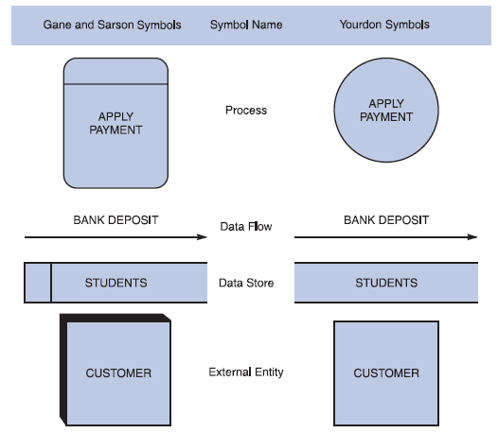
Data Flow Diagram Symbols
Four basic symbols represent processes, data flows, data stores, and entities

Slide 7
Sources/Sink (External Entities)
Represent another department, a business, a person, or a machine
A source or destination of data, outside the boundaries of the system
Should be named with a noun
Entity symbol
Shows how the system interfaces with the outside world
DFD shows only external entities that provide data to the system or receive output
DFD entities also are called terminators because they are data origins or final destinations
Source and sink entities
Notes:
An external entity (outside the boundaries of the system) sends data to (source) or receives data from (destination) the system.
Each entity is labeled with a name, generally a noun.
The same entity may be used more than once on a given data flow diagram.

Slide 8
Process
Denotes a change in or transformation of data
Represents work being performed in the system
Naming convention:
Assign the name of the whole system when naming a high-level process
Use the form verb-adjective-noun for detailed processes
Process symbols
Process receives input data and produces output
Contains business logic that transforms the data
Process name identifies a specific function
In DFDs, a process symbol can be referred to as a black box
Notes:
The data flow leaving a process is always labeled differently then the data flow entering the process.
A process must also be given a unique identifying number indicating its level in the diagram.

Slide 9
Data Store
A depository for data that allows examination, addition, and retrieval of data
Represent data that the system stores
Named with a noun, describing the data
Data stores are usually given a unique reference number, such as D1, D2, D3
DFD does not show the detailed contents of a data store
Specific structure and data elements are defined in the data dictionary
Notes:
The data flow leaving a process is always labeled differently then the data flow entering the process.
A process must also be given a unique identifying number indicating its level in the diagram.

Slide 10
Data Store
A data store must be connected to a process with a data flow
Represents a:
Database
Computerized file
Filing cabinet
Notes:
The data flow leaving a process is always labeled differently then the data flow entering the process.
A process must also be given a unique identifying number indicating its level in the diagram.

Slide 11
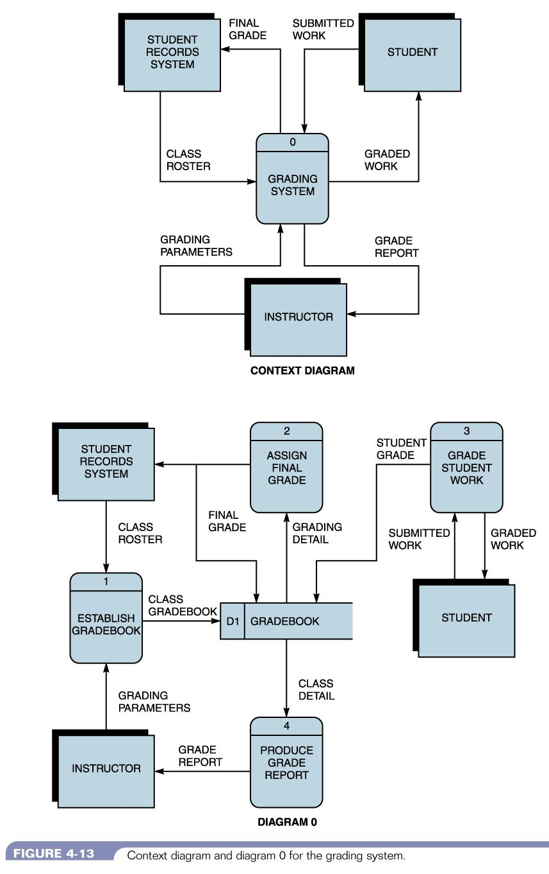
DFD Example 1 http://faculty.ccri.edu/kelly/COMP1230/Examples/DFDEx.jpg

Slide 12
Rules Governing Data Flow Diagramming
Process
No process can have only outputs. If an object has only outputs, then it must be a source
No process can have only inputs. If an object has only inputs, then it must be a sink
A process has a verb phrase label
Data Store
Data store can not move directly from one data store to another data store. Data must be moved by a process
Data can not move directly from an outside source to a data store. Data must be moved by a process that receives data from the source and places the data into the data store
Data can not move directly to an outside sink from a data store. Data must be moved by a process
Data store has a noun phrase label

Slide 13
Rules Governing Data Flow Diagramming
Source/Sink
Data can not move directly from a source to a sink. It must be moved by a process if the data are of any concern to our system. Otherwise, data flow data flow is not shown on the DFD
A source / Sink has a noun phrase label

Slide 14
Rules Governing Data Flow Diagramming
Data Flow
A Data flow has only one direction of flow between symbols. It may flow in both directions between a process and a data store to show a read before an update. The later is usually indicated, however, by two separate arrows because these happen at different times
A fork in a data flow means that exactly the same data goes from a common location to two or more different processes, data stores, or sources/sinks (indicating different copies of the same data going to different locations)

Slide 15
Rules Governing Data Flow Diagramming
Data Flow
A join in data flow means that exactly the same data came from any of two or more different processes, data stores, or sources /sinks to a common location
A data flow cannot go directly back to the same process it leaves. There must be at least one other process that handles the data flow, produces some other data flow, and returns the original data flow to the beginning process
A data flow to a data store means update (delete or change)
A data flow from a data store means retrieve or use
A data flow has a noun phrase label. More than one data flow noun phrase can appear on a single arrow as long as all of the flows on the same arrow move together as one package.

Slide 16
Steps in Developing Data Flow Diagrams (1 of 2)
Developing Data Flow Diagrams Using a Top-Down Approach
1. Make a list of business activities and use it to determine various
External entities
Data flows
Processes
Data stores
Create a context diagram that shows external entities and data flows to and from the system. Do not show any detailed processes or data stores.
Draw Diagram 0, the next level. Show processes, but keep them general. Show data stores at this level.

Slide 17
Steps in Developing Data Flow Diagrams (2 of 2)
Create a child diagram for each of the processes in Diagram 0.
Check for errors and make sure the labels you assign to each process and data flow are meaningful.
Develop a physical data flow diagram from the logical data flow diagram. Distinguish between manual and automated processes, describe actual files and reports by name, and add controls to indicate when processes are complete or errors occur.
Partition the physical data flow diagram by separating or grouping parts of the diagram in order to facilitate programming and implementation.
Notes:
Data flow diagrams can and should be drawn systematically.
To begin a data flow diagram, collapse the organization’s system narrative into a list with four categories of external entity, data flow, process, and data store. This list helps determine the boundaries of the system. Next begin drawing the context diagram.

Slide 18
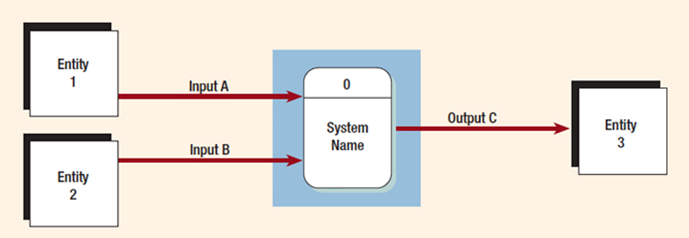
Creating the Context Diagram
The highest level in a data flow diagram
Contains only one process, representing the entire system
The process is given the number 0
All external entities, as well as major data flows are shown
Notes:
Basically the context diagram consists of:
one process—depicting the entire system
external entities
data flows from the external entities to the process
The diagram does not contain any data stores.

Slide 19
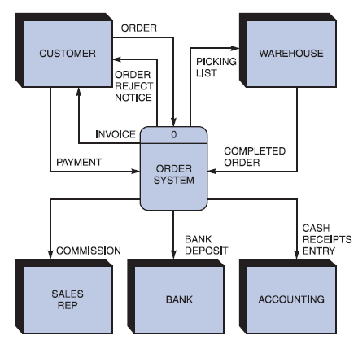
Drawing a Context Diagram
First step in
constructing a
set of DFDs
Context diagram DFD for an order system.

Slide 20
Drawing Diagram 0 (1 of 2)
The explosion of the context diagram
May include up to nine processes
Each process is numbered
Major data stores and all external entities are included
Notes:
Including more than nine processes will result in a cluttered diagram that is difficult to understand.
Each process is numbered with an integer, starting form the upper left-hand corner and working toward the lower right-hand corner.
Because a data flow diagram is two-dimensional, you can start at any point and work forward or backward through the diagram.

Slide 21
Data Flow Diagram Levels
Data flow diagrams are built in layers
The top level is the context level
Each process may explode to a lower level
The lower level diagram number is the same as the parent process number
Processes that do not create a child diagram are called primitive

Slide 22
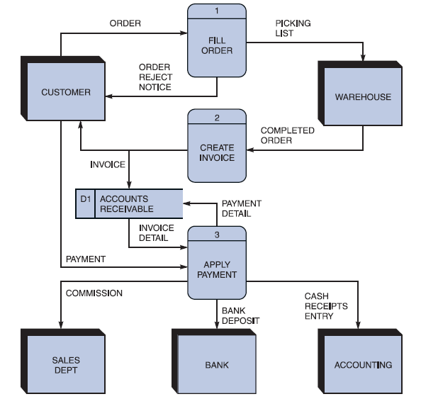
Drawing a Diagram 0 DFD
Shows the detail inside the black box
Diagram 0 DFD for the order system.

Slide 23
Creating Child Diagrams
Each process on diagram 0 may be exploded to create a child diagram
A child diagram cannot produce output or receive input that the parent process does not also produce or receive
The child process is given the same number as the parent process
Process 3 would explode to Diagram 3
Notes:
The process on Diagram 0 that is exploded is called the parent process, and the diagram that results is called the child diagram.
On Diagram 3, the processes would be numbered 3.1, 3.2, 3.3, and so on. This allows the analyst to trace a series of processes through many levels of explosion.

Slide 24
Creating Child Diagrams
Entities are usually not shown on the child diagrams below Diagram 0
If the parent process has data flow connecting to a data store, the child diagram may include the data store as well
When a process is not exploded, it is called a primitive process
Notes:
In addition, the lower-level diagram may contain data stores not shown on the parent process.

Slide 25
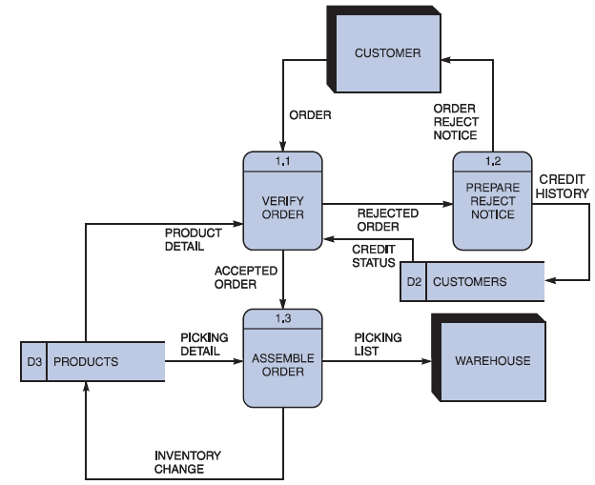
Drawing Lower-Level DFDs
Diagram 1 DFD shows details of the FILLORDER process in the order system

Slide 26
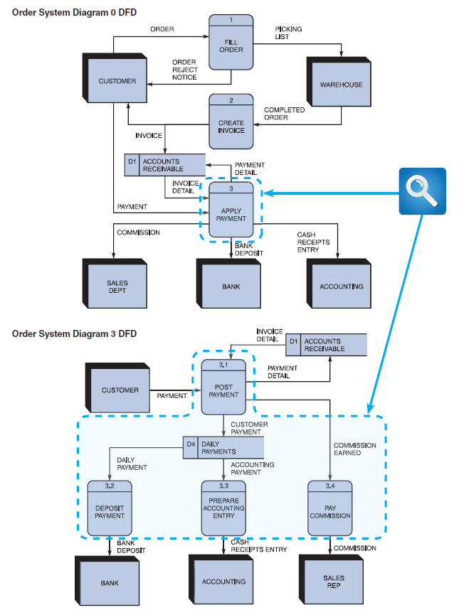
Drawing Lower-Level DFDs (3 of 5)
FIGURE 5-16 The order system diagram 0 is shown at the top of the figure, and exploded diagram 3 DFD (for the APPLY PAYMENT process) is shown at the bottom. The two DFDs are balanced because the child diagram at the bottom has the same input and output flows as the parent process 3 shown at the top.

Slide 27


